Slide 1
Online Food Ordering & Delivery Management System
Presented by: Murgan Swami M & Lokesh V
Project Guide: Vijaya
Institution: Anudip Foundation
Course: Advance Java Programming

Slide 2
Introduction
• A console-based food ordering and delivery
management application.
• Built using Core Java, Hibernate ORM, MySQL,
and JDBC.
• Helps users register, log in, browse restaurants,
view menu, and place orders.

Slide 3
Project Objectives
• Provide digital food ordering functionality.
• Maintain secure user authentication.
• Manage restaurants, menus, and orders
efficiently.
• Generate sales report using JDBC.

Slide 4
Technologies Used
• Programming Language: Java
• Backend Framework: Hibernate ORM
• Database: MySQL
• Tools: Eclipse, Maven
• Build Tool: Maven

Slide 5
System Architecture
Presentation/UI Layer (Console input/output)
Service Layer (Business logic)
DAO Layer (CRUD operations)
Hibernate Layer (ORM communication)
Database Layer (MySQL storage)

Slide 6
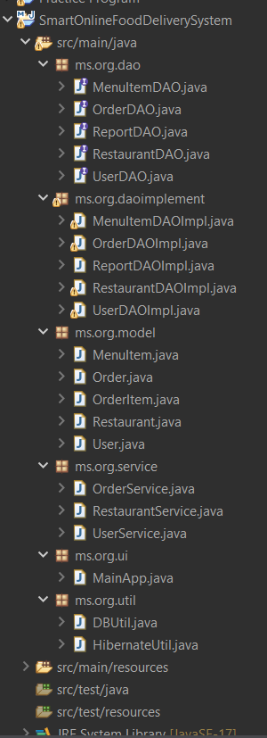

Slide 7
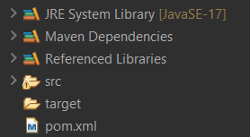

Slide 8
Features - User Module
• User Registration & Login
• View Restaurants
• Browse Menu Items
• Place Order
• View Order History

Slide 9
Features - Admin Module
• Insert Restaurants & Menu Items (via DB)
• View Total Sales Report
• Maintain Food Records

Slide 10
Database Design
Tables Used:
users
restaurants
menu_items
orders
order_items

Slide 11
Application Flow
Start → Register/Login → View Restaurants → View Menu → Place Order → Bill Summary

Slide 12
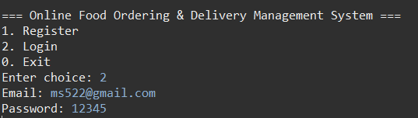

Output
Login/Registration successful
Menu displayed with price

Slide 13

Output
Orders managed successfully
Reports generated

Slide 14
Advantages
Real-world based application
Scalable modular design
Database driven & secure
Easy to integrate with web or mobile app

Slide 15
Conclusion
Successfully implemented food ordering system.
Learned Hibernate, MySQL, and JDBC integration.
Future scope: UI, Online payments, Delivery tracking.

Slide 16
Thank You

